Slide 1

LINEAR INTEGRATED CIRCUITS
UNIT-I OPERATIONAL AMPLIFIERS

Slide 2
INTRODUCTION
Operational Amplifiers (Op-amps)are basically a voltage amplifying device designed to be used with components like capacitors and resistors, between its in/out terminals.
Feedback components like these are used to determine the operation of the amplifier.
The amplifier can perform many different operations (resistive, capacitive, or both) hence called Operational Amplifier.
Operational amplifiers now become a fundamental building block used throughout the electronics industry.

Slide 3
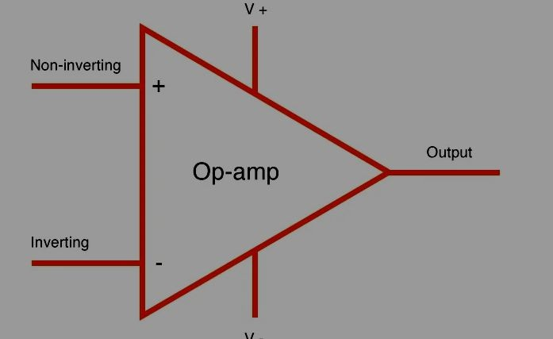
Symbol
The operational amplifier has two inputs.
One is called the inverting input and is marked with a "-" sign
The other is the non-inverting input and this is marked with a "+" sign.

Slide 4
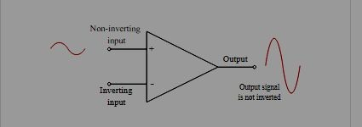
Non-inverting input terminal
Positive voltage applied to the non-inverting input will produce a positive swing at the output.
If a changing waveform, such as a sine wave is applied to the non-inverting input, it will appear as same at the output.
Output will not be inverted

Slide 5
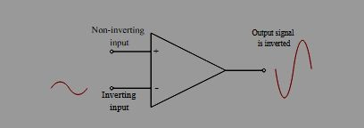
Inverting input terminal
A positive voltage applied to the inverting input will produce a negative swing at the output.
Sine was applied to the inverting input, will appear as inverted at the output.

Slide 6
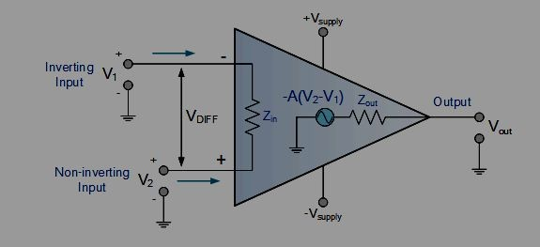
Op-amp Operation
If the same voltage is applied to both inputs together then there should be no change at the output.
Output between inputs.
is proportional the inverting
to the difference and non-inverting
These amplifiers are ofien called differential amplifiers.

Slide 7
The amplifier differential inputs consist of a non-inverting input with voltage (V+) and an inverting input with voltage (V−).
Op-amp amplifies only voltage between the
the difference in two, also called
differential input voltage.
V_{out} = A_{OL} (V₁ –
2
The output voltage of_{V}t₎he op-amp V_{out} is given
Where AOL – Open Loop Gain
An operational amplifier only responds to the difference between the voltages on its two input terminals called “Differential Input Voltage” and not to their common potential.

Slide 8


Characteristics of Operational Amplifier
Open loop voltage gain
The open loop voltage gain of an op-amp is its differential gain without any feedback path.
Output oﬀset voltage
The voltage present at the output of an op-amp when its differential input voltage is zero is called as output oﬀset voltage
Common Mode Rejection Ratio
Common Mode Rejection Ratio (CMRR) of an op-amp is defined as the ratio of the differential gain, Ad and the common mode gain, Ac.

Slide 9

Note: Common mode gain, Ac of an op-amp is the ratio of the common mode output voltage and the common mode input voltage.
Slew Rate
Slew rate of an op-amp is defined as the maximum rate of change of the output voltage due to a step input voltage.
Slew rate is measured in either V/μSec or V/mSec

Slide 10
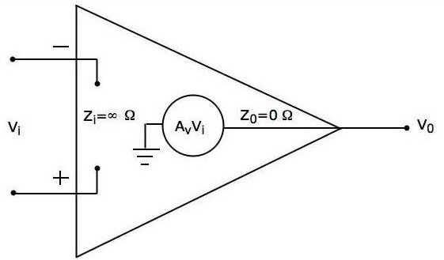
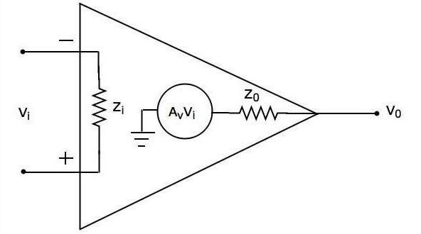
Types of Operational Ampliﬁers
Ideal op- amp -Exists only in theory, and does not exist practically
Practical op- amp-Practically, deviate from their ideal characteristics because of some imperfections during manufacturing.

Slide 11
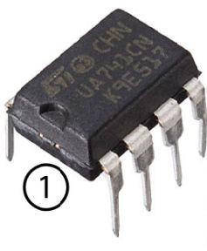
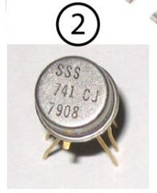
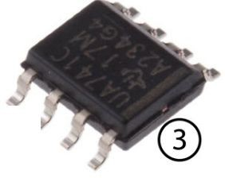
This Op-amp IC comes in the following form factors:
8 Pin DIP Package
TO5-8 Metal can package
8 Pin SOIC

Slide 12
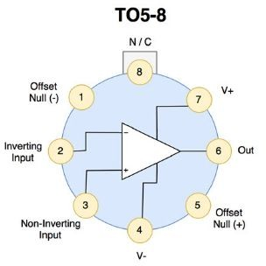
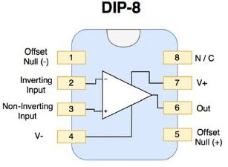
Pinout of IC 741 Op Amp

Slide 13
Inverting Operational Amplifier
Inverting Ampliﬁer
In this type of amplifier the o/p is precisely 180 degrees out of phase to input.
When the +Ve voltage is applied to the circuit, then the o/p of the circuit will be –Ve
Operational amplifier is connected feedback to produce a closed operation(Gain)
with loop
Virtual Ground
Concept used in Op-Amps in which a node is assumed to have the potential that of the ground terminal.

Slide 14
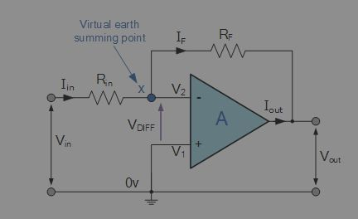
Circuit Diagram

Slide 15
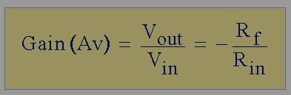
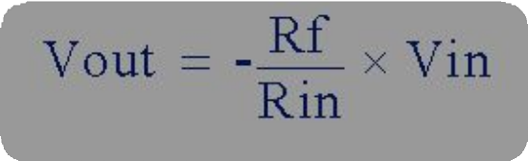
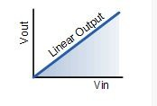
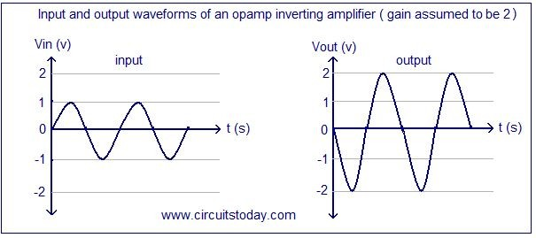
The negative sign in the equation indicates an inversion of the output signal with respect to the input as it is 180º out of phase.
This is due to the feedback being negative in value.
The equation for the output voltage Vout also shows that the circuit is linear in nature

Slide 16
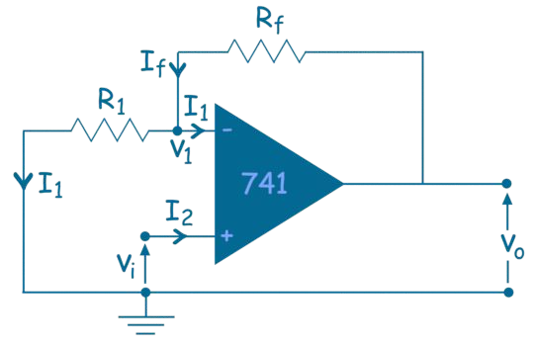
Non- Inverting Operational Amplifier
Input voltage signal, ( V_{IN} ) is applied directly to the non-inverting ( + ) input terminal and another terminal is grounded.
Output signal is “in-phase” with the input signal
Feedback control of the non-inverting operational amplifier is achieved by applying a small part of the output voltage signal back to the inverting ( – ) input terminal via Rƒ and R1

Slide 17
Adder or Summing Amplifier
The Summing Ampliﬁer is a type of operational amplifier circuit configuration that is used to combine the voltages present on two or more inputs into a single output voltage.
Here more than one input is applied to either in inverting or non inverting input terminals
Types
Inverting Summing ampliﬁer
Non inverting Summing ampliﬁer

Slide 18
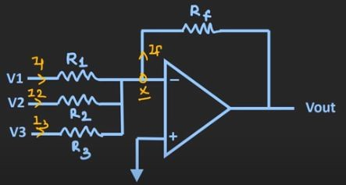
Inverting Summing amplifier
Input voltages V1, V2, V3 are applied to the inverting terminal through resistors R1, R2, R3
Assume Currents I1, I2, I3 are flowing through R1, R2, R3
Current If flowing through Rf

Slide 19
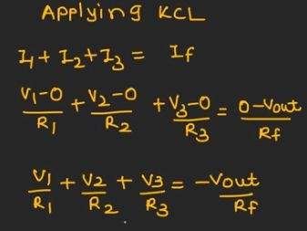
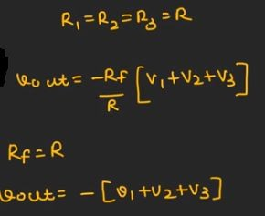

By concept of virtual ground, V⁺ = V_{x} = 0 Applying KCL in input side,

Slide 20
Applications
Providing DC offset
ADC converters
Audio mixers
Non- Inverting Summing amplifier
Input voltages V1, V2 are applied to the non inverting terminal through resistors R1, R2, R
Assume Currents I1, I2, are flowing through R1, R2
Current If flowing through Rf

Slide 21
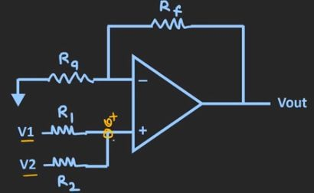
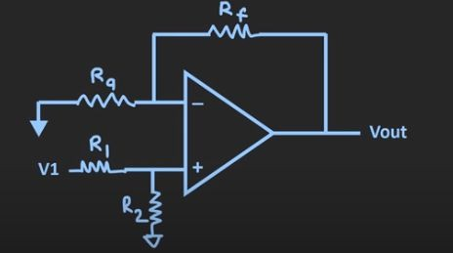
Since two or more volgates applied at input at a time, we have to find the value of Vx by principle of superposition.
V1 is acting and V2 =0

Slide 22
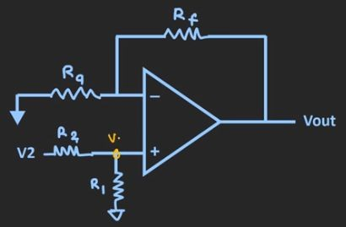
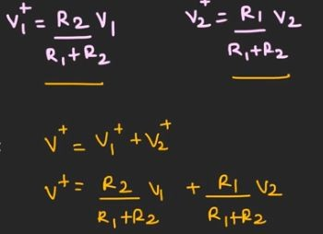

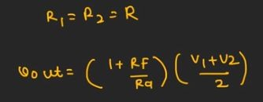

V2 is acting and V1 =0

Slide 23
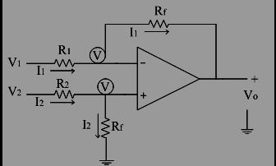
Subtractor /Difference Amplifier
The subtraction of the two input voltages is possible with the help of subtractor.
It is also called as difference amplifier.
Uses both the inverting and non-inverting inputs to produce an output signal which is the difference between the two input voltages

Slide 24
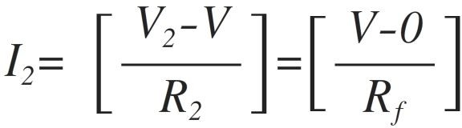
The input signals applied are V1 and V2.
Let us assume that the non-inverting terminal is at potential 'V'.
Due to virtual ground concept, the inverting terminal appears to be at the same potential 'V‘
Let the current flowing through resistance R1 and R2 are I1 and I2 respectively
From circuit, Current I2 can be written as

Slide 25
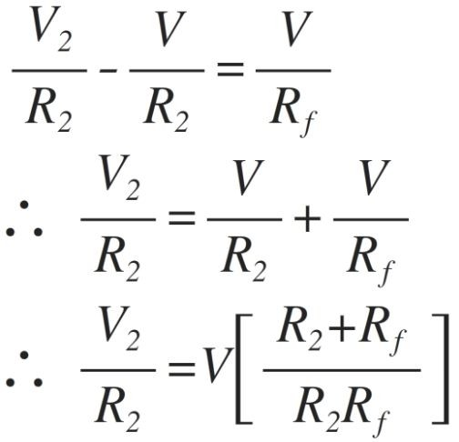
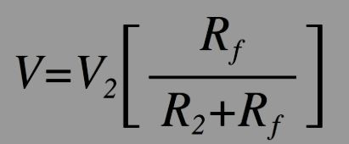
From the above equation voltage 'V' can be calculated as

Slide 26
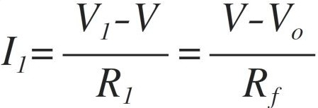
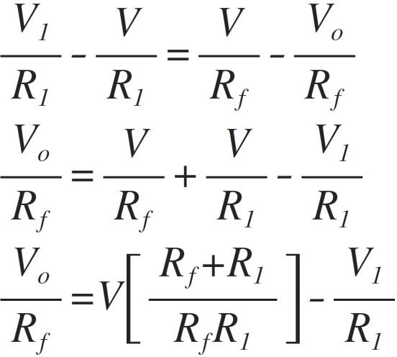
The current I1 is given as
Simplify the equation,

Slide 27
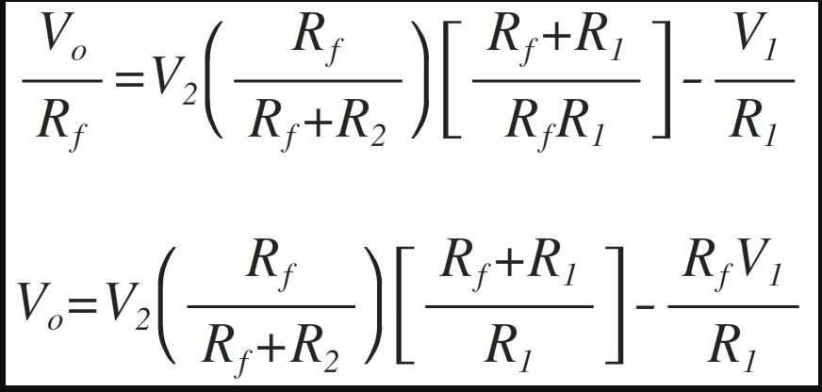
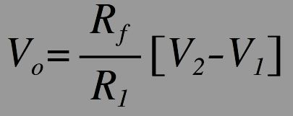

Substituting the voltage 'V' from the equation we get,
If R1=R2,
If R1=R2=Rf,

Slide 28
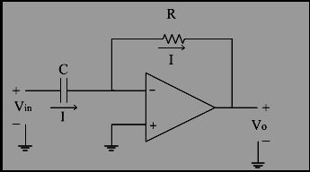
Differentiator
An op-amp differentiator is a circuit configuration which produces output voltage amplitude that is proportional to the rate of change of the applied input voltage.
Differentiator with only RC network is called a passive differentiator,
Differentiator with active circuit components like transistors and operational amplifiers is called an active differentiator.

Slide 29
Analysis
The input signal to the differentiator is applied to the capacitor.
The capacitor blocks any DC content so there is no current flow to the amplifier summing point, X resulting in zero output voltage.
The capacitor only allows AC type input voltage changes to pass through and whose frequency is dependant on the rate of change of the input signal.
At low frequencies the reactance of the capacitor is “High” resulting in a low gain ( Rƒ/Xc ) and low output voltage from the op-amp.
At higher frequencies the reactance of the capacitor is much lower resulting in a higher gain and higher output voltage from the differentiator

Slide 30
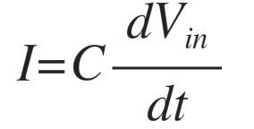
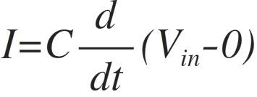
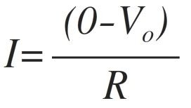
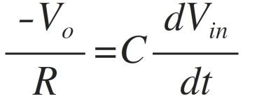
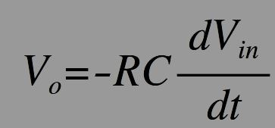
Node voltage of the operational amplifier at its inverting input terminal is zero, the current, I flowing through the capacitor
Same current 'I' flows through Feedback resistance R is
(2)
Equating both the above equations of 'I‘

Slide 31
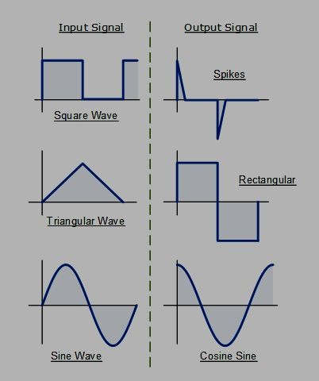
Thus output voltage is nothing but time differentiation of the input signal and hence acting as differentiator.
'RC' is the time constant of the differentiator.
Response of the diﬀerentiator to diﬀerent input signals.

Slide 32
Op-amp Integrator
A circuit in which output voltage waveform is the time integral of the input voltage waveform is called integrator or integrating amplifier.
Integrator circuit which consists of active devices is called an Active integrator.
Provides a much lower output resistance and higher output voltage
An op-amp integrating circuit produces an output voltage which is proportional to the area (amplitude multiplied by time) contained under the waveform.

Slide 33
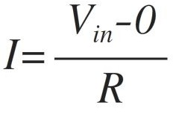
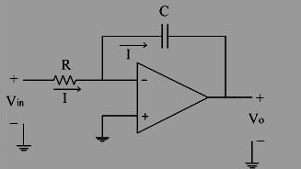
The non-inverting input terminal is at ground potential and hence, the inverting terminal is appearing to be at ground potential.
The current 'I' through the resistance R is given as,
(1)

Slide 34
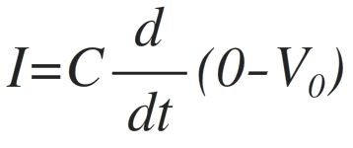
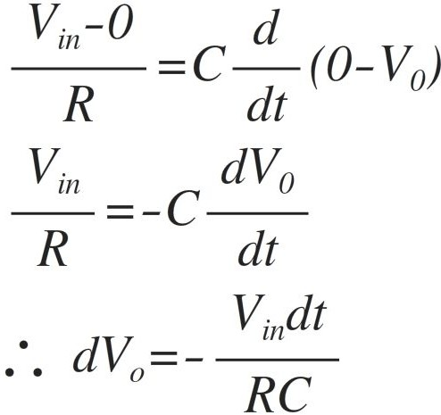
Same current 'I' flows through the capacitor 'C' in feedback path given as
Equating 1 & 2

Slide 35
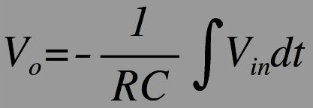
Integrating both the sides,
Where – 1/RC=≫Gain of an integrator.
Output voltage is nothing but time integration of the input signal and hence acting as an integrator.

Slide 36
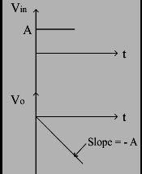
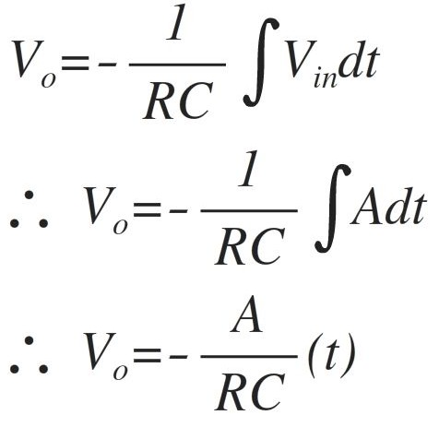
Positive step signal, output is a negative ramp signal with slope(-A/RC).
At a particular't', integrator goes into negative saturation, so continuous dc signal is avoided for integrator.

Slide 37
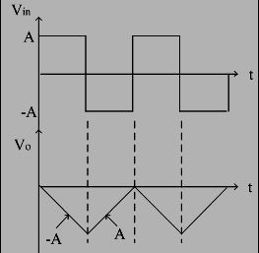
Vin = Square Wave
The square wave is nothing but combination of positive and negative step signals.
For positive step signal, a negative ramp and for negative step signal, positive ramp is obtained because of inverting integrator.
Thus for a square wave input, the output obtained is a triangular waveform

Slide 38
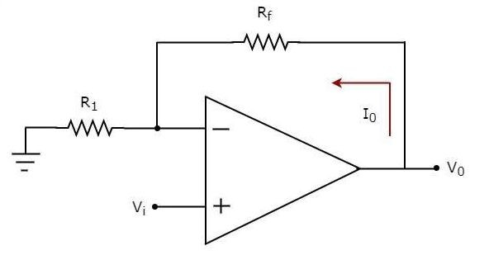
Voltage to Current Converter
A voltage to current converter or V to I converter, is an electronic circuit that takes voltage as the input and produces current as the output.

Slide 39
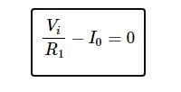

Input voltage Vi is applied at the non-inverting input terminal of the op-amp.
According to the virtual short concept, the voltage at the inverting input terminal of an op-amp will be equal to the voltage at its non-inverting input terminal .
The nodal equation at the inverting input terminal's node is
Output current I0 of a voltage to current converter is the ratio of its input
voltage Vi and resistance R1

Slide 40

We can re-write the above equation as
The above equation represents the ratio of the output current I0 and the input voltage Vi & it is equal to the reciprocal of resistance R1.
The ratio of the output current I0 and the input voltage Vi is called as Transconductance.

Slide 41

Current to Voltage Converter
A current to voltage converter or I to V converter is an electronic circuit that takes current as the input and produces voltage as the output.

Slide 42

An op-amp based current to voltage converter produces an output voltage when current is applied to its inverting terminal.
Non-inverting input terminal of the op-amp is connected to ground.
According to the virtual short concept, the voltage at the inverting input terminal of an op-amp will be equal to the voltage at its non-inverting input terminal.
Voltage at the inverting input terminal of the op-amp will be zero volts.
The nodal equation at the inverting terminal's node

Slide 43

Output voltage, V0 is having a negative sign, which indicates that there exists a 180⁰ phase difference between the input current and output voltage.
We can re-write the above equation as
The ratio of output voltage V0 and input current Ii is called as Transresistance.

Slide 44
Instrumentation Amplifier
An instrumentation amplifier is used to amplify very low-level signals, rejecting noise and interference signals.
Instrumentation Amplifier provides the most important function of Common-Mode Rejection (CMRR).
It cancels out any signals that have the same potential on both the inputs.
The signals that have a potential difference

Slide 45




Instrumentation Amplifiers
An instrumentation amplifier (IA) amplifies the voltage difference between its terminals. It is optimized for small differential signals that may be riding on a large common mode voltages.
The gain is set by a single resistor that is supplied by the user.
The output voltage is the closed loop gain set by R_{G} multiplied by the voltage difference in the inputs.

Slide 46

Instrumentation Amplifier using Op Amp
The most commonly used Instrumentation amplifiers consist of three op-amps.
V0 = AvF * Vd Where, Vd = Vo1 – Vo2

Slide 47

Expression for Output Voltage

Slide 48


Slide 49
Applications of Instrumentation Amplifier
They are used extensively in Bio-medical applications like ECG’s and EEG’s.
Instrumentation Amplifiers are used where long-term stability is essential like Industrial applications that includes automation.
Instrumentation amplifiers are incorporated with pressure transducers in Weighing Systems to monitor various physical quantities such as weight, force, pressure, displacement and torque.

Slide 50
Wave Shaping Circuits
Wave shaping circuits are the electronic circuits, which produce the desired shape at the output from the applied input wave form.
These circuits perform two functions
Attenuate the applied wave
Alter the level of the applied wave.
Types of wave shaping circuits
✔ Clippers
✔ Clampers

Slide 51
Op-amp based Clippers
Electronic circuit that produces an output by removing a part of the input above or below a reference value.
Output of a clipper will be same as that of the input for other than the clipped part.
Due to this, the peak to peak amplitude of the output of a clipper will be always less than that of the input.
Clippers can be classiﬁed into the following two types based on the clipping portion of the input.
Positive Clipper
Negative Clipper

Slide 52

Positive Clipper
A positive clipper clips only portion(s) of the input signal.
the positive
Sinusoidal voltage signal Vt is applied to the non-inverting terminal of the op-amp.
The value of the reference voltage Vref can be chosen by varying the resistor R2 .

Slide 53
Circuit Operation
✔ If the value of the input voltage Vi is less than the value of the reference voltage Vref, then the diode D₁ conducts.
✔ Circuit behaves as a voltage follower.
✔ Output voltage Vo of the above circuit will be same as that of the input voltage Vi
✔ If the value of the input voltage Vi is greater than the value of reference voltage Vref, then the diode D₁ will be off.
✔ Op-amp operates in an open loop since the feedback path was open.
✔ Output voltage V0 of the above circuit will be equal to the value of the reference voltage Vref

Slide 54


Waveforms

Slide 55

Negative Clipper
Clipper that clips only the negative portion(s) of the input signal.
Circuit of the negative clipper obtained by reversing the diode and taking the reverse polarity of the reference voltage
Sinusoidal voltage signal Vi is applied to the non-inverting terminal of the op-amp.
The value of the reference voltage Vref can be chosen by varying the resistor R2

Slide 56
Operation
If the value of the input voltage Vt is greater than the value of reference voltage Vref, then the diode D₁ conducts.
Circuit behaves as a voltage follower.
Output voltage V0 of the above circuit will be same as that of the input voltage
If the value of the input voltage Vi is less than the value of reference voltage , then the diode D₁ will be off.
Now, the op-amp operates in an open loop since the feedback path is open.
Output voltage V0 of the above circuit will be equal to the value of reference voltage ,Vref

Slide 57

Waveforms

Slide 58
Applications of Clippers
In the case of generating new waveforms and/or shaping the existing older waveforms.
Clippers can be used as freewheeling diodes in protecting the transistors from transient effects by connecting the diodes in parallel
Frequently used in FM transmitters for removing the excess ripples in the signals above a certain noise level.

Slide 59
Op-amp-Clampers
The circuit which can set the positive or negative peak of the input AC signal at a required level is what we call as a clamping circuit.
A clamper is an electronic circuit that produces an output, which is similar to the input but with a shift in the DC level.
Clampers are used to introduce or restore the DC level of input signal at the output.
There are two types of op-amp based clampers
Positive Clamper
Negative Clamper

Slide 60

Positive Clamper
Positive clamper is a clamper circuit that produces an output in such a way that the input signal gets shified vertically by a positive DC value.

Slide 61
Operation
Sinusoidal voltage signal, Vi is applied to the inverting terminal of op-amp through a network that consists of a capacitor C1 and a resistor R1
Reference voltage Vref is applied to the non-inverting terminal of the op-amp.
The value of reference voltage Vref can be chosen by varying the resistor R2
If reference voltage Vref is positive value, circuit produces an output, which is the combination (resultant sum) of the sinusoidal voltage signal Vi and the reference voltage Vref
Sinusoidal voltage signal Vi gets shified vertically upwards by the value of reference voltage Vref

Slide 62

Waveforms

Slide 63

Negative Clamper
A negative clamper is a clamper circuit that produces an output in such a way that the input signal gets shified vertically by a negative DC value.

Slide 64
Operation
Sinusoidal voltage signal Vi is applied to the inverting terminal of the op-amp through a network that consists of a capacitor C₁ and resistor R1
Reference voltage Vref is applied to the non-inverting terminal of the op-amp.
The value of reference voltage Vref can be chosen by varying the resistor R2
Reference voltage Vref of a negative value.
Circuit produces an output, which is the combination (resultant sum) of sinusoidal voltage signal Vi and reference voltage Vref

Slide 65


Waveforms

Slide 66

Problem-1

Slide 67


Solution
To find o/p voltage we have to consider the sources individually acting and finally add them together to get overall o/p voltage.
Case i: V1 is acting alone and V2=0 ( Inverting op-amp)
Due to virtual ground, voltage at 2R also zero

Slide 68




Case ii: V2 is acting alone and V1=0 (
Non-Inverting op-amp)
R and 2R are in parallel

